Slide 1

Cyber wolf 2.0 S.K.P Engeenering college
Team members:
Tamilselvan.s
Sharmila.r
Varshini.m
Vishali priya.k

Slide 2
AI-Powered Student Risk Prediction System
Problem Statement
Proposed solution
Educational institutions often struggle to identify students who are at risk of poor academic performance or dropping out at an early stage. Traditional monitoring methods are manual, time-consuming, and reactive, resulting in delayed interventions and reduced student success.
Our solution uses Machine Learning to analyze students' academic performance and engagement data, such as attendance, assignment scores, quiz marks, LMS activity, and late submissions. The system predicts whether a student is at risk, explains the reasons behind the prediction using Explainable AI (SHAP), and provides personalized intervention recommendations through an interactive dashboard. This enables educators to take proactive actions and improve student outcomes.

Slide 3
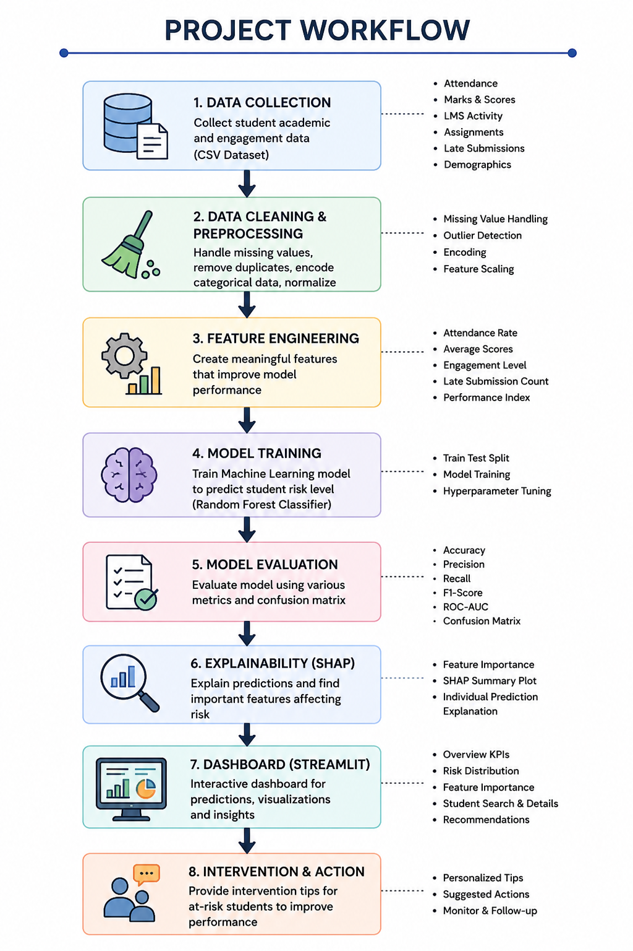

Slide 4
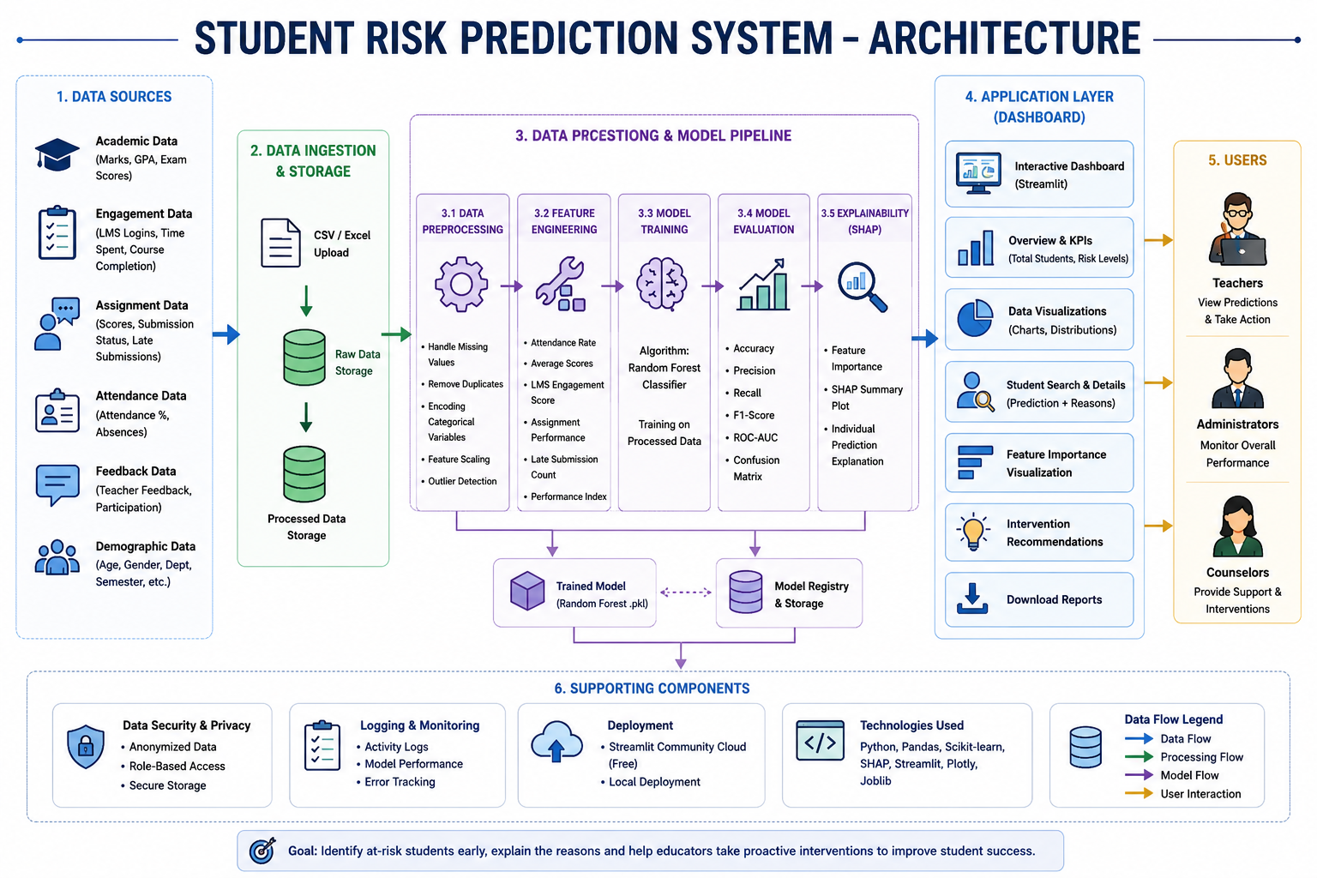

Slide 5
Thank you

